Slide 1
Lecture 11 Decision Tree & Random Forest
CS582
Machine Learning: Getting Computers
to Program Themselves
“Discovering the Learning Dynamics of the Laws of Nature”
Dr. Emdad Khan
ekhan@mum.edu
Prof. of Computer Science
Maharishi International University
March, 2022

Slide 2
Decision trees
Non-linear classifier
Easy to use
Easy to interpret
Succeptible to overfitting but can be avoided.

Slide 3
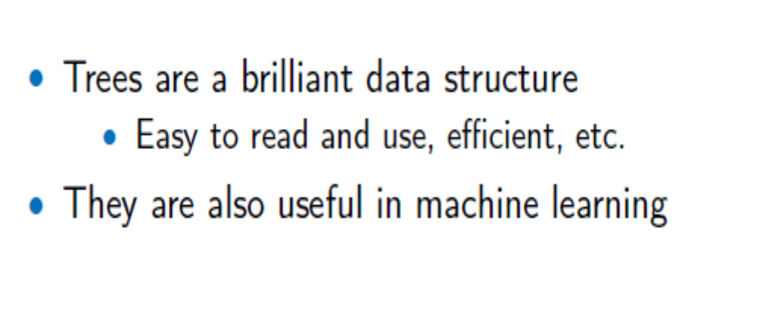
Decision Trees

Slide 4
Anatomy of a decision tree
Each node is a test on
one attribute
Outlook
sunny
overcast
rain
Possible attribute values
of the node
Humidity
Yes
Windy
high
normal
true
false
Leafs are the decisions
No
Yes
No
Yes

Slide 5
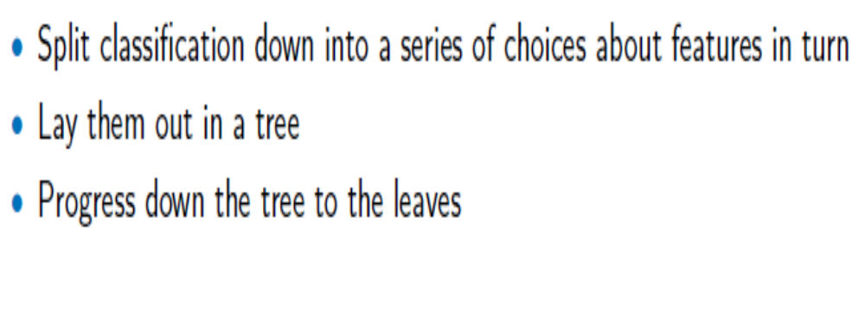
Unsupervised Learning

Slide 6
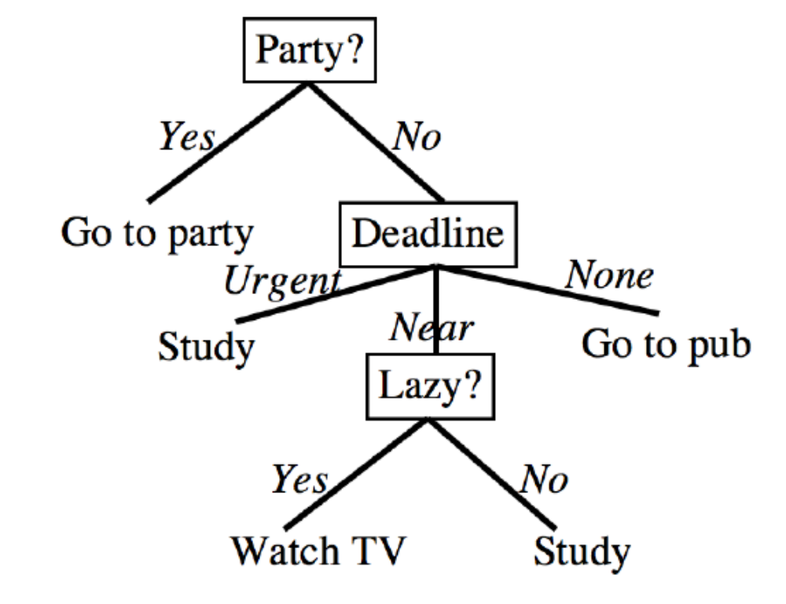
Another Example

Slide 7
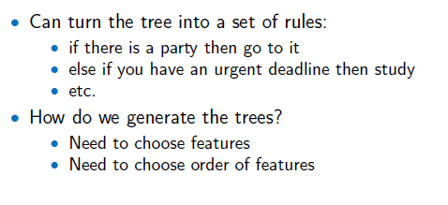
Rules and Decision Trees

Slide 8
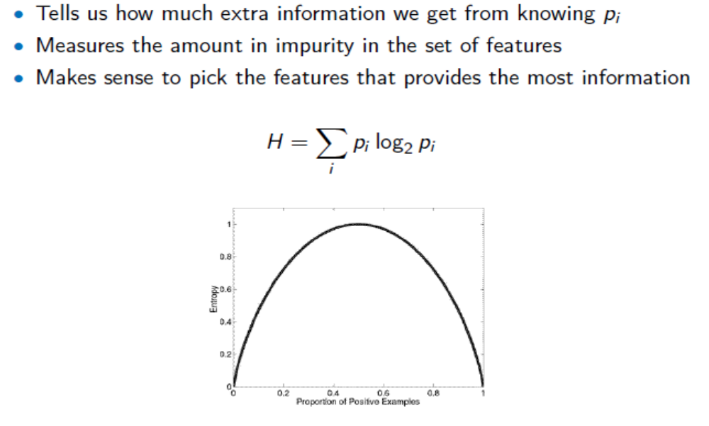
Entropy
Note – add a minus sign before sum

Slide 9
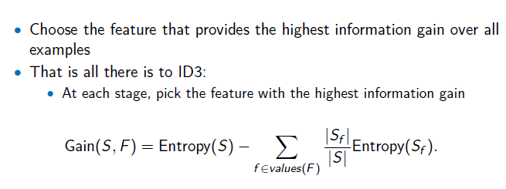
Information Gain

Slide 10
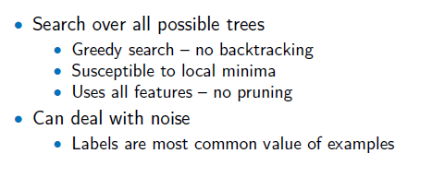
ID3 Algorithm (Quinlan) to Build Tree

Slide 11
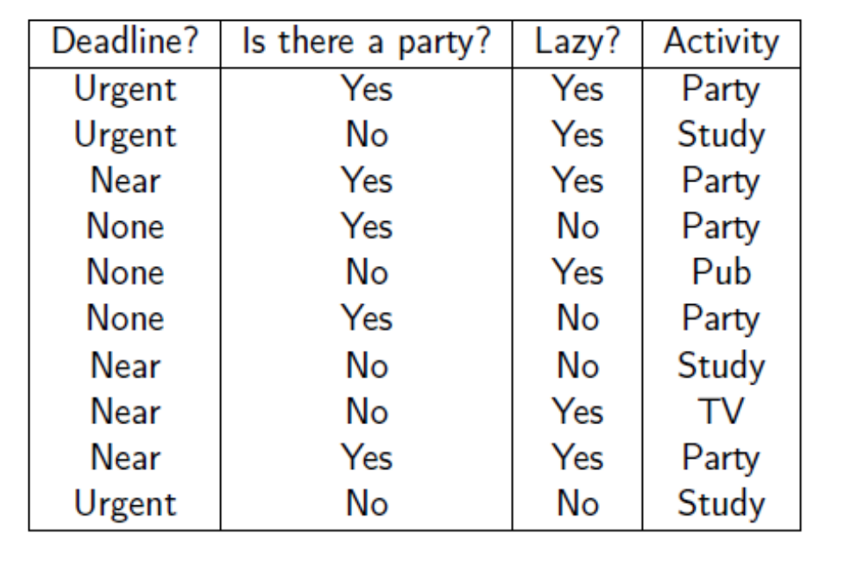
Example – Training Set

Slide 12
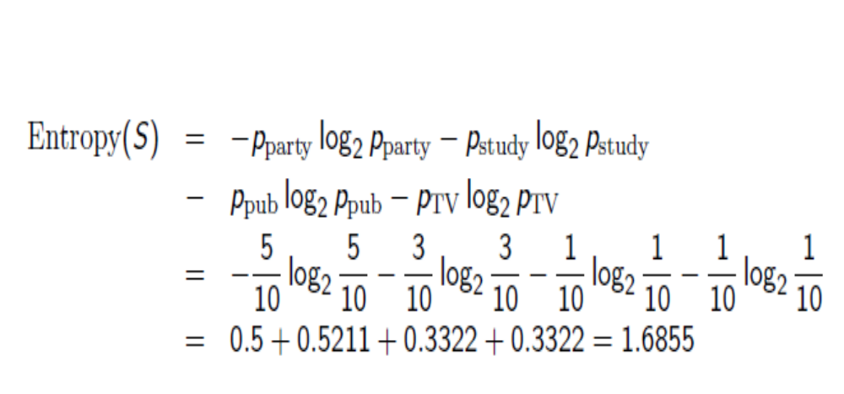
Example – Entropy Computation

Slide 13
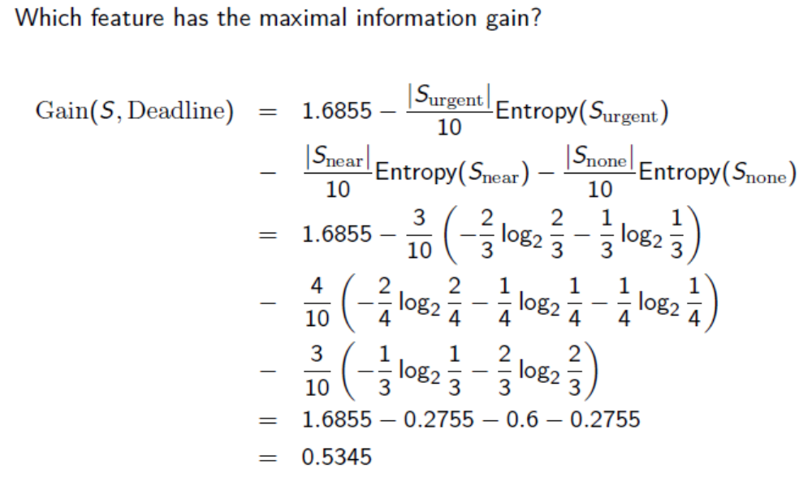
Example: Gain-1

Slide 14
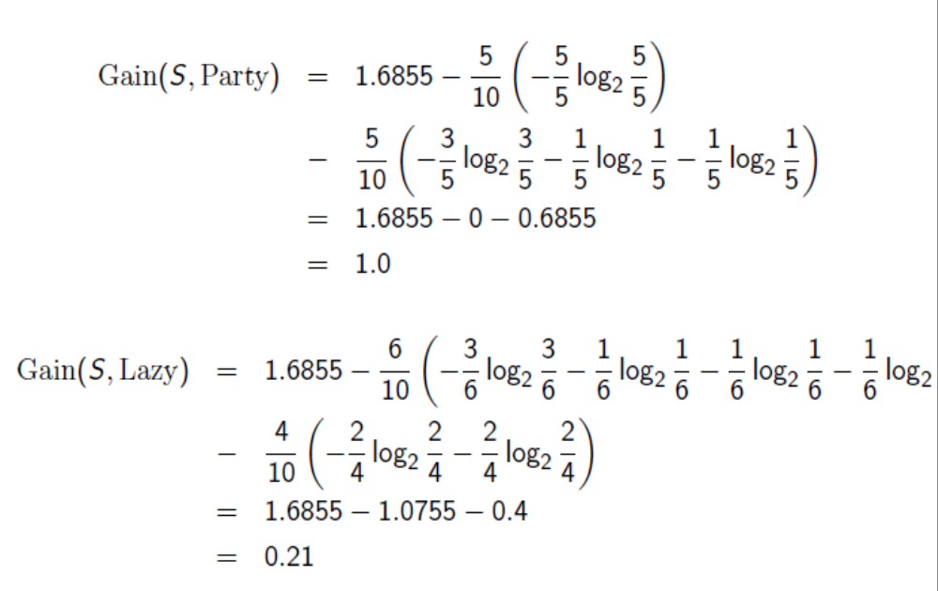
Example: Gain-2

Slide 15
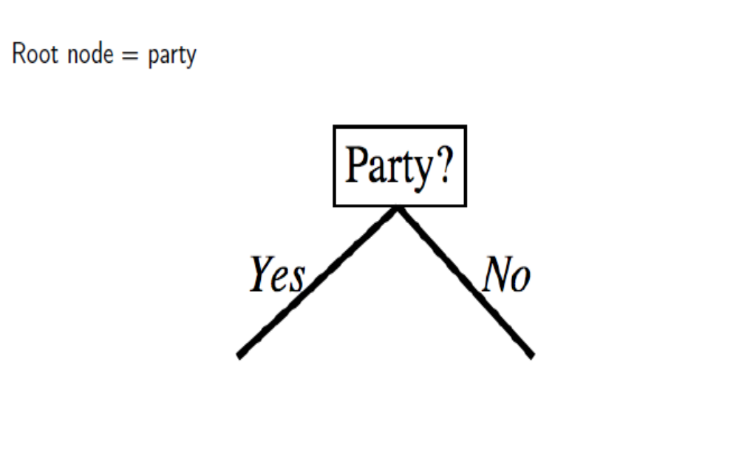
Building Tree Using Entropy-1

Slide 16
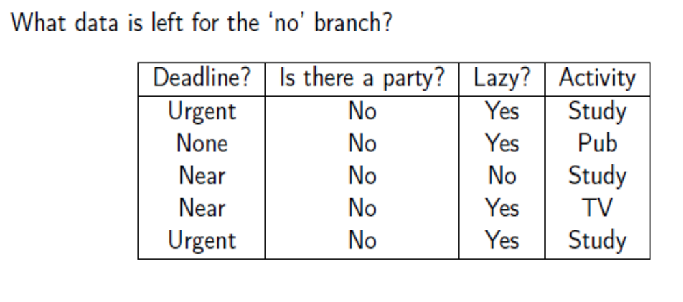
Building Tree Using Entropy - 2

Slide 17
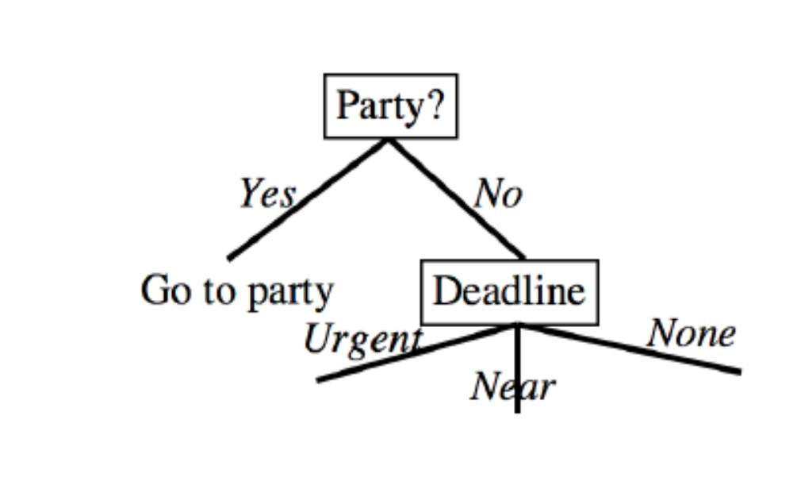
Building Tree Using Entropy-3

Slide 18
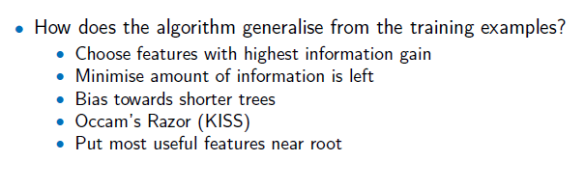
Key Ideas in ID3

Slide 19
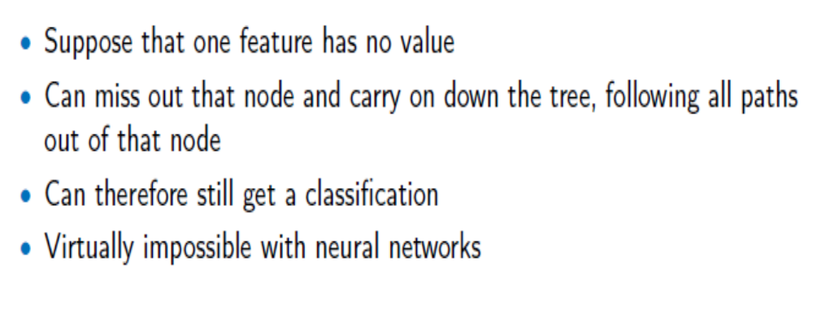
Missing Data

Slide 20
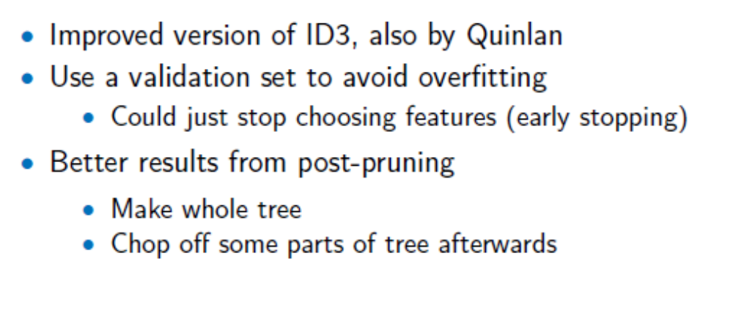
C4.5

Slide 21
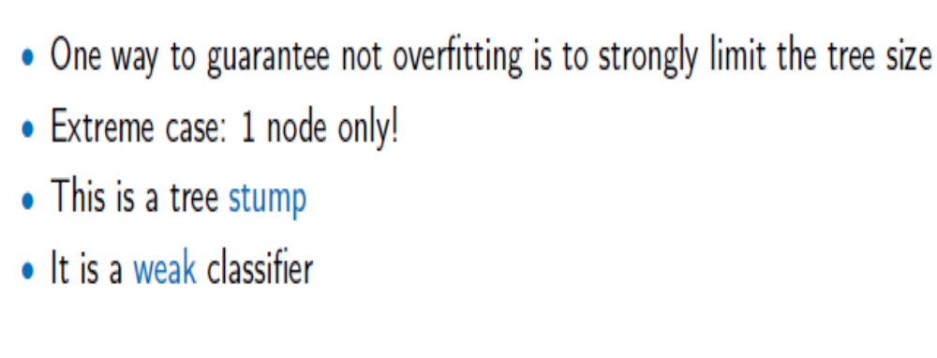
Stumping

Slide 22
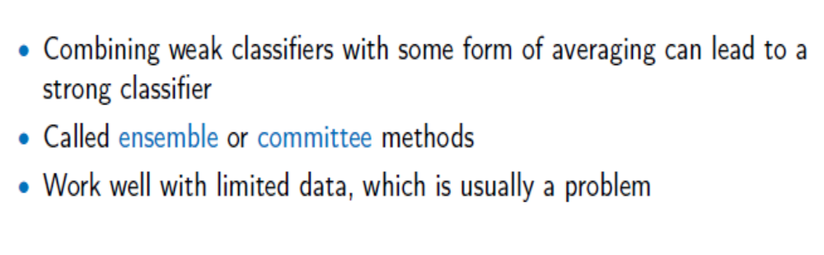
Ensemble or Committee
Key Idea – Two Heads are better than one!

Slide 23
Random Forest Classifier
Training Data
M features
N examples
Use Bootstrap i.e. take samples from original dataset with replacement, so that we may get some data several times and some others not at all. Same size as the original data, and lots of such samples are taken (Next slide)
Notes:
As the classifier of choice we adopt Random Forest Classifier, due to its robustness to heterogenous and noisy feature.
Random Forest is an ensembe classifier. Briefly, given N data and M features, bootsrap samples are created from the traning data

Slide 24
Random Forest Classifier
Create bootstrap samples
from the training data
M features
N examples
....…

Slide 25
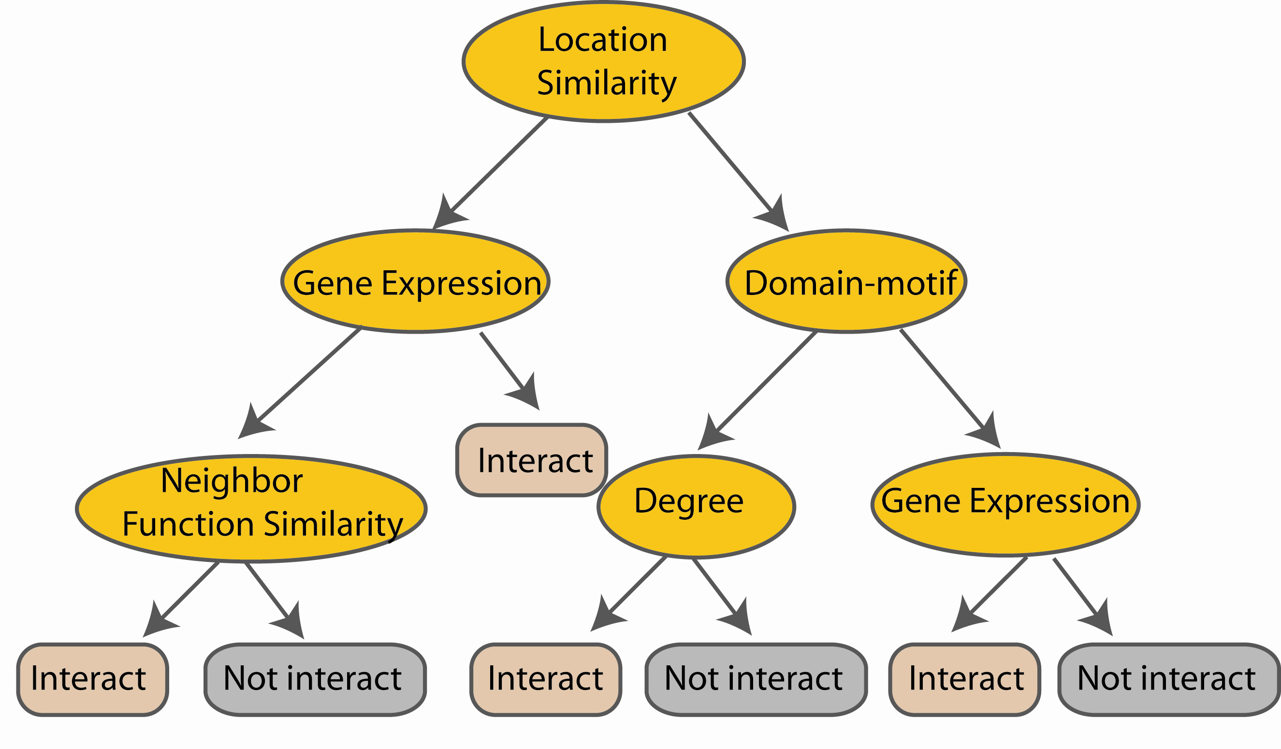
Random Forest Classifier
Construct a decision tree
M features
N examples
....…
Notes:
From eachd descision tree .. In spliting the nodes, the Gini Gain is employed

Slide 26
Random Forest Classifier
At each node in choosing the split feature
choose only among m<M features
M features
N examples
....…
Notes:
Different from the regular decision trees in random forest, when the splitting feature is chosen from only a subset of allf eatures.
The robostness of the classifier arises from
bootsraping of the training data and the random selection of features, the the random choose of features.

Slide 27
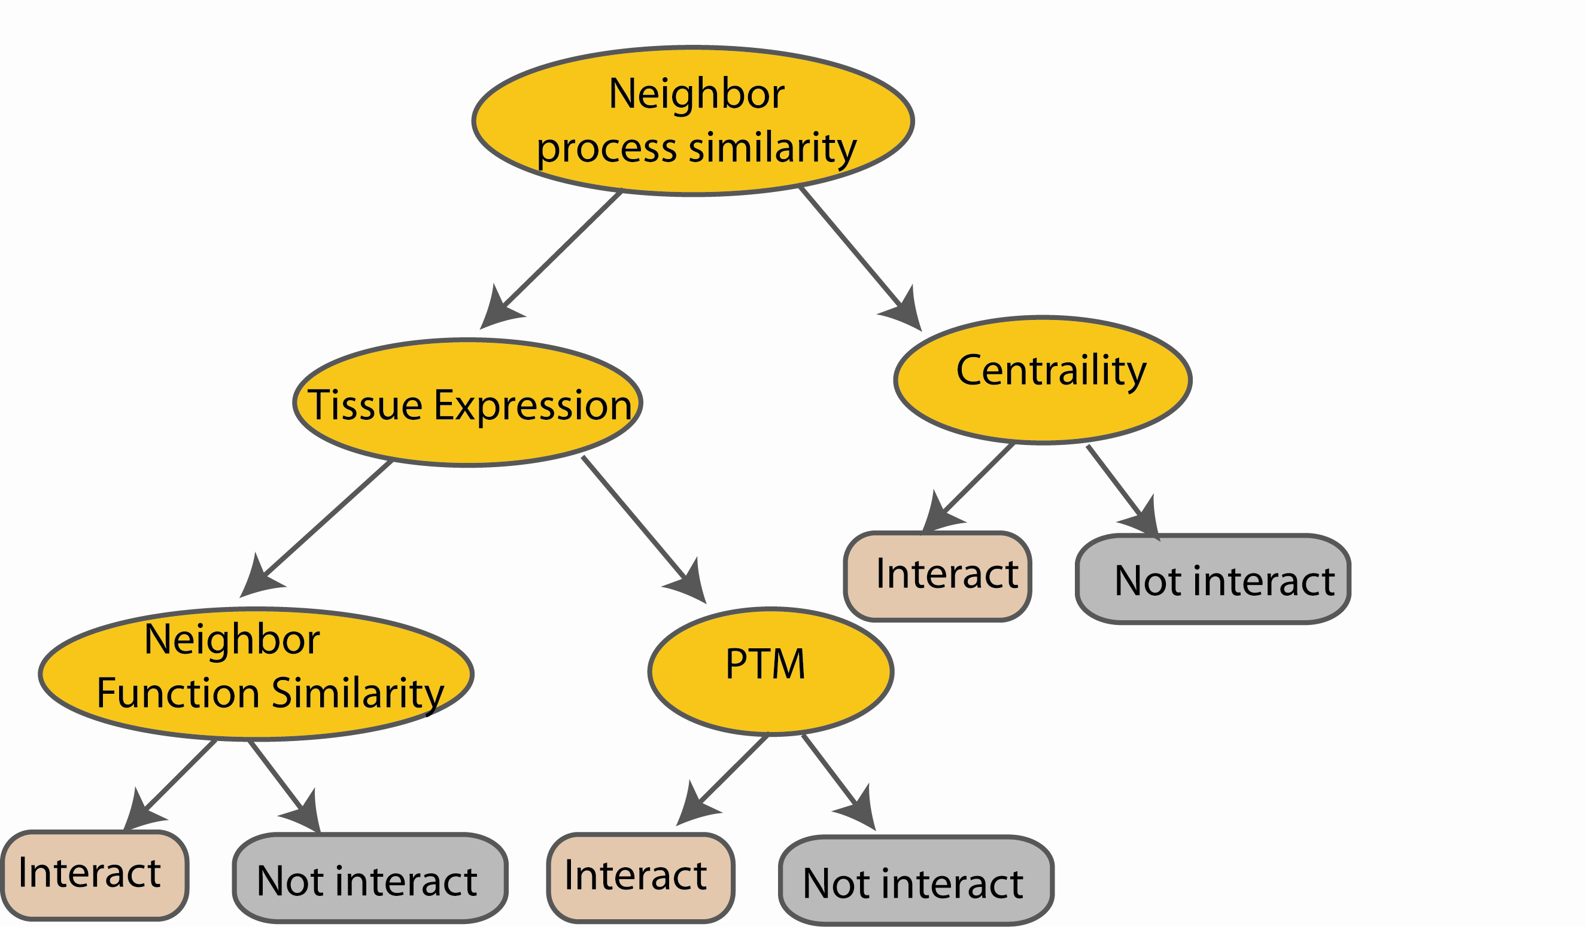
Random Forest Classifier
Create decision tree
from each bootstrap sample
M features
N examples
....…
....…

Slide 28
Random Forest Classifier
M features
N examples
Take he majority vote
....…
....…
Notes:
Finally the given an input data the decision is made as follows given an input data,

